Slide 1
DALL E 2.0
By: Amr Abdalbadee
Danu

Slide 2
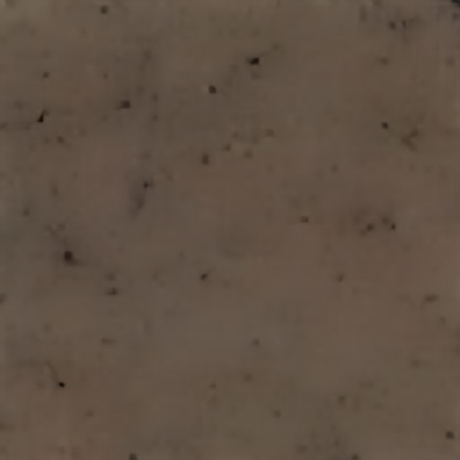
Noise photo

Slide 3
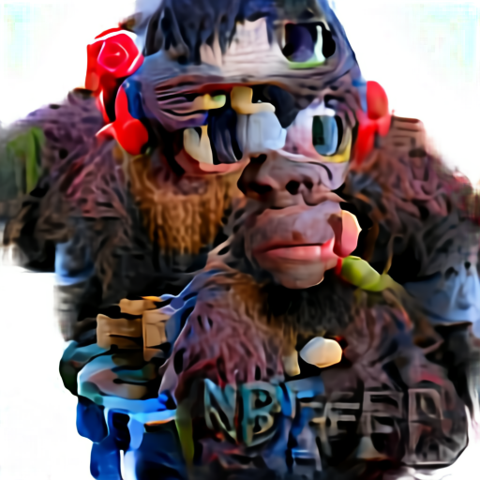
3D rendered version of bored ape NFT

Slide 4
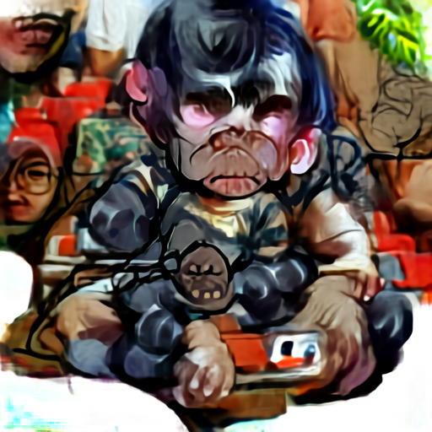
baby version of bored ape NFT

Slide 5
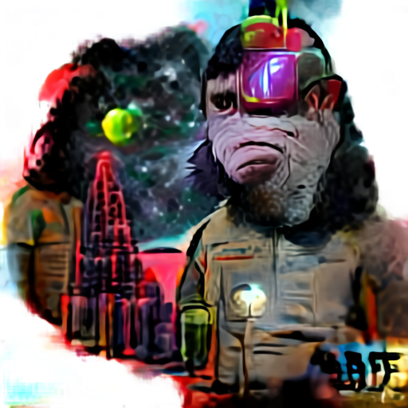
Sci-fi version of bored ape NFT

Slide 6
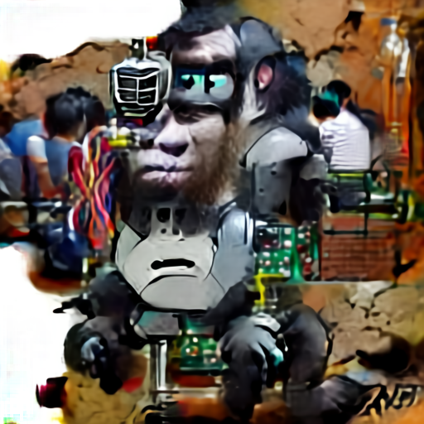
Robotic version of bored ape NFT

Slide 7
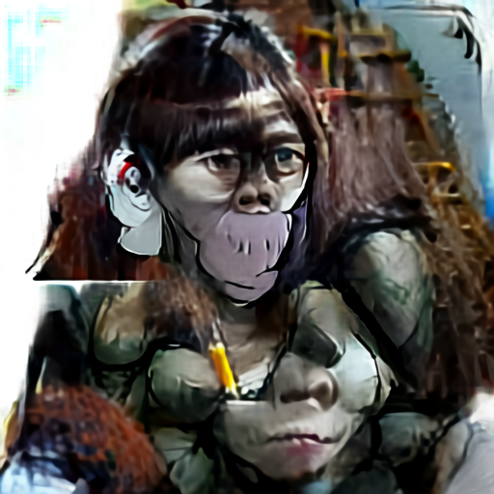
Female version of bored ape NFT

Slide 8
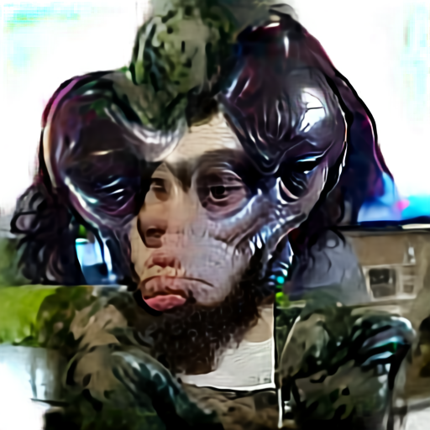
Alien version of bored ape NFT

Slide 9
Conclusion
Stable diffusion takes a photo as an input, while this version of DALL E generates images from noisy scratch input.
DALL E is more creative than stable diffusion, it can creates creative original images like ones in next slide.

Slide 10
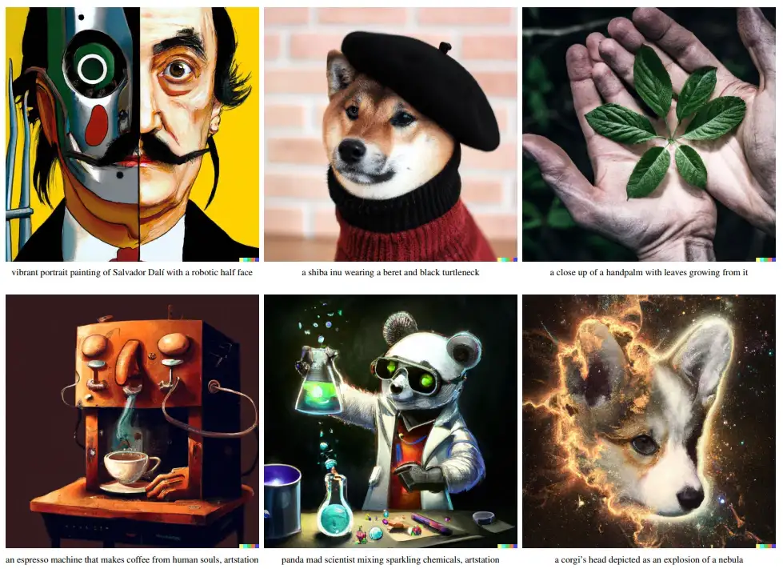

Slide 11
DALL E Mini
This version of DALL E 2.0 was taken from this medium article: https://towardsdatascience.com/e-dall-e-creating-digital-art-with-varying-aspect-ratios-5de260f4713d
Maximum size of input photos is 512*512 using Colab premium GPU.
This is not the official DALL E version, as the last is in closed form.
The system has two main components: DALL-E Mini for image generation and E-DALL-E for expanding the aspect ratio.
These photos are generated using aspect ratio 19:6

Slide 12
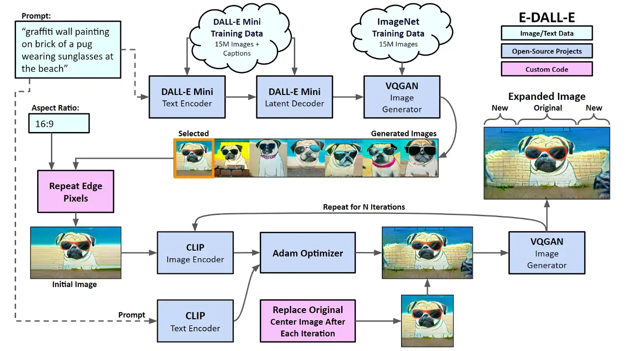

Slide 13
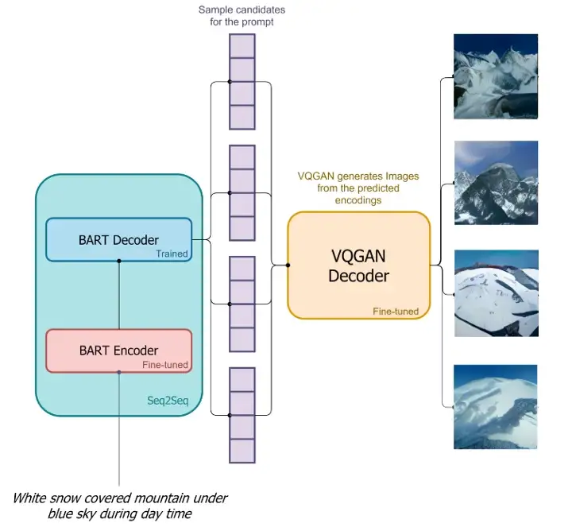

Slide 14
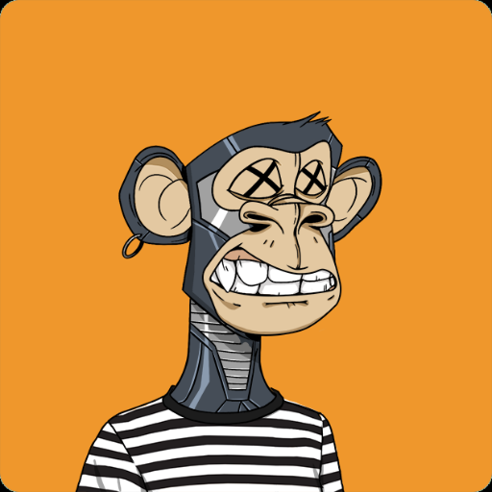
baby version of this ape

Slide 15
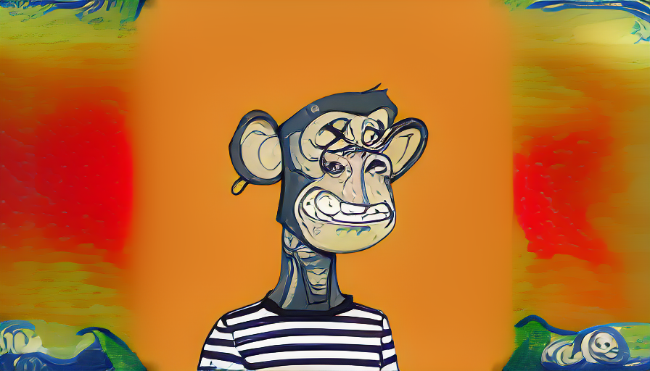

Slide 16
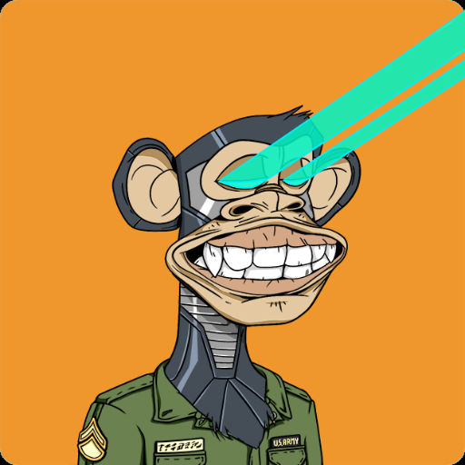

Slide 17
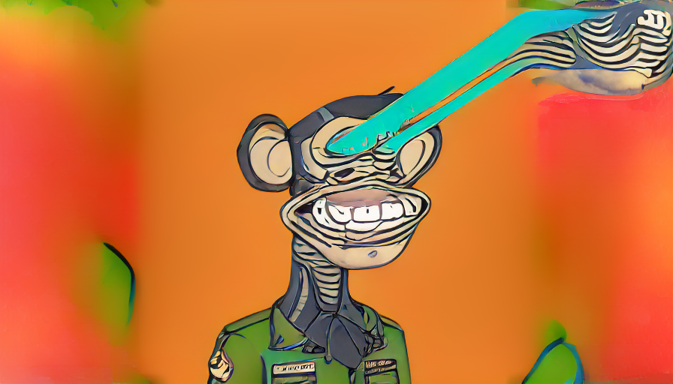

Slide 18
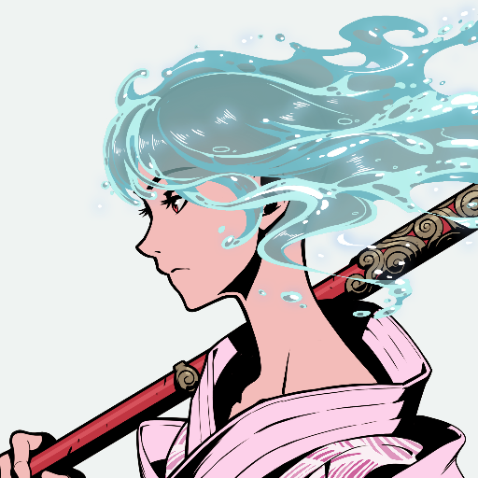
An oil-painted version of this photo

Slide 19
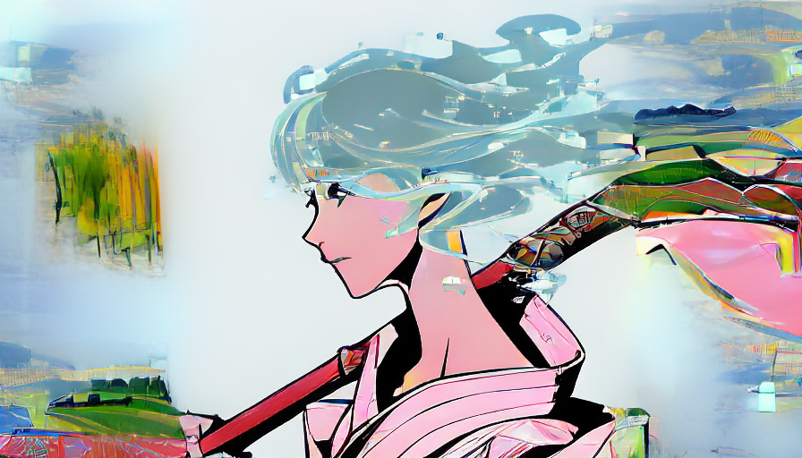

Slide 20
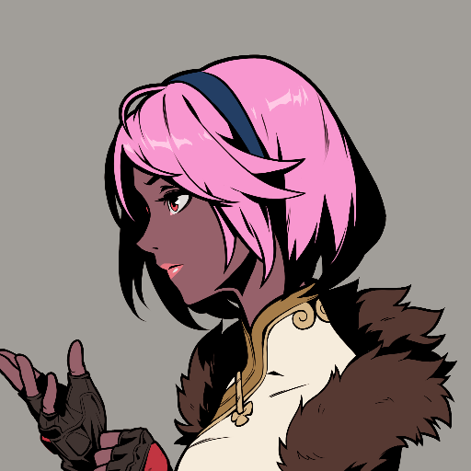
Disney style of this photo

Slide 21
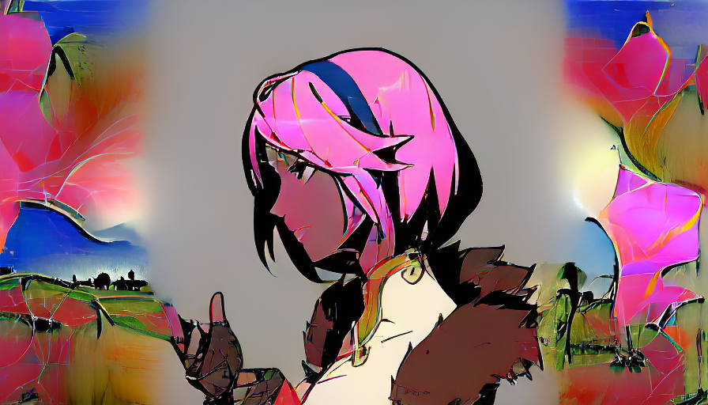

Slide 22
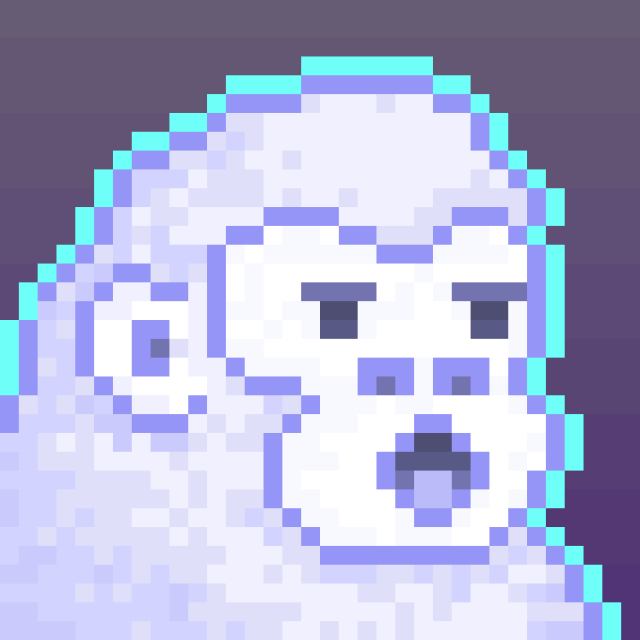
depixelated version of this ape

Slide 23
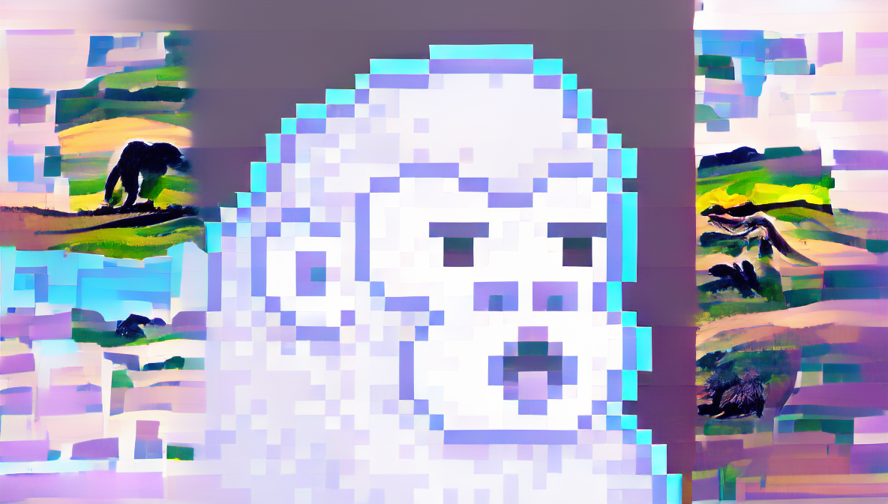

Slide 24

Add beard to this ape

Slide 25
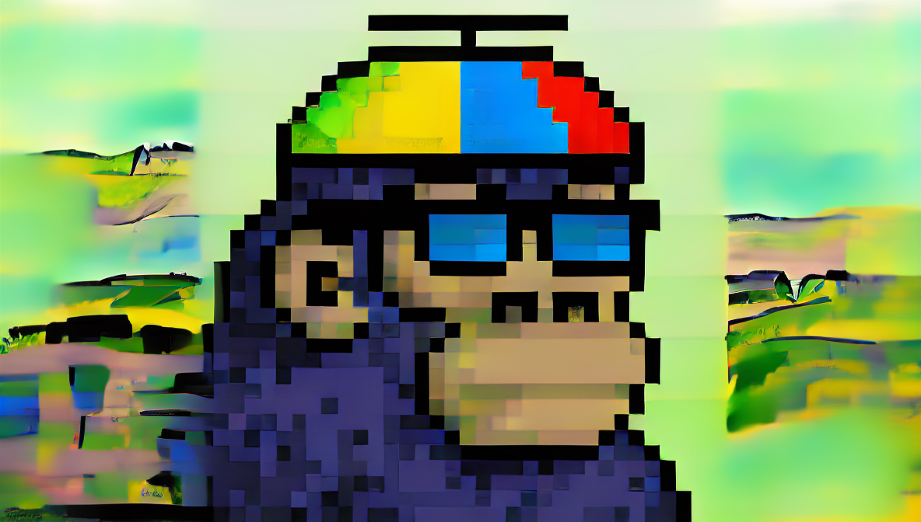

Slide 26
Conclusion
It seems that DALL E mini failed to change NFT features based on text prompt commands.
It only changes NTFs background.

Slide 27
Playground AI
Stable diffusion 1.5

Slide 28
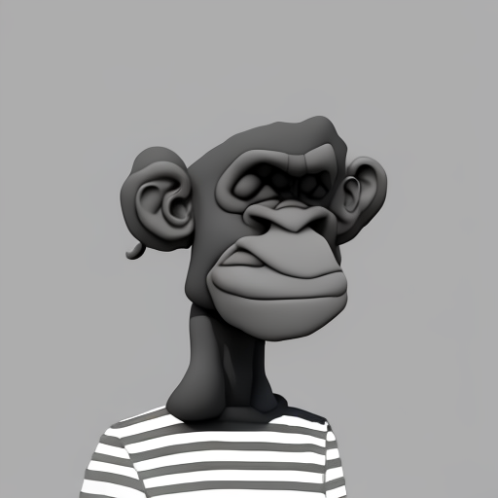
3D rendered version of bored ape NFT

Slide 29
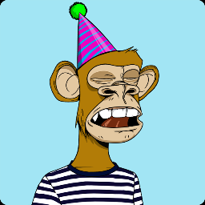
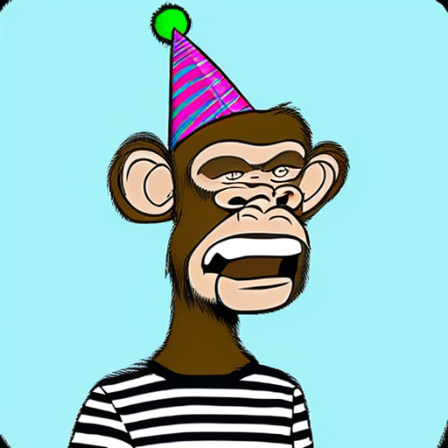
happy version of this ape NFT

Slide 30

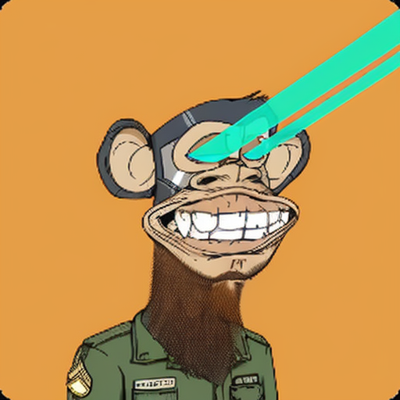
Add beard to this photo

